Slide 1


WEB CLIENT
This Photo by Unknown author is licensed under CC BY.

Slide 2

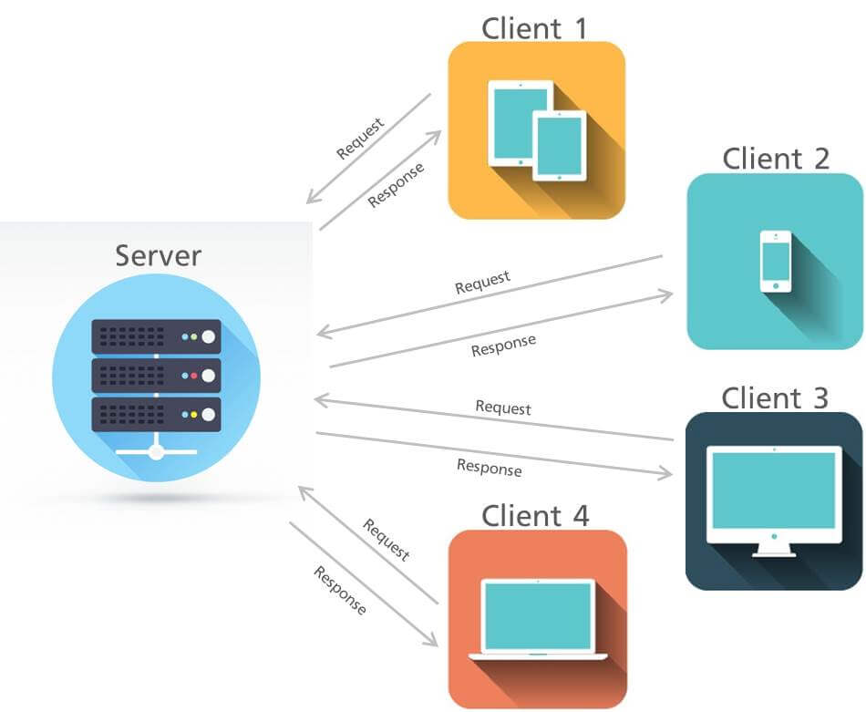
WHAT IS WEBCLIENT:
A web client is an application that communicates with a web server using Hypertext Transfer Protocol (HTTP). It acts as an interface between the server and clients, allowing users to interact with the web server.. It is typically a web browser or web app which displays web pages received from the server and allows users to interact with the web server.

Slide 3
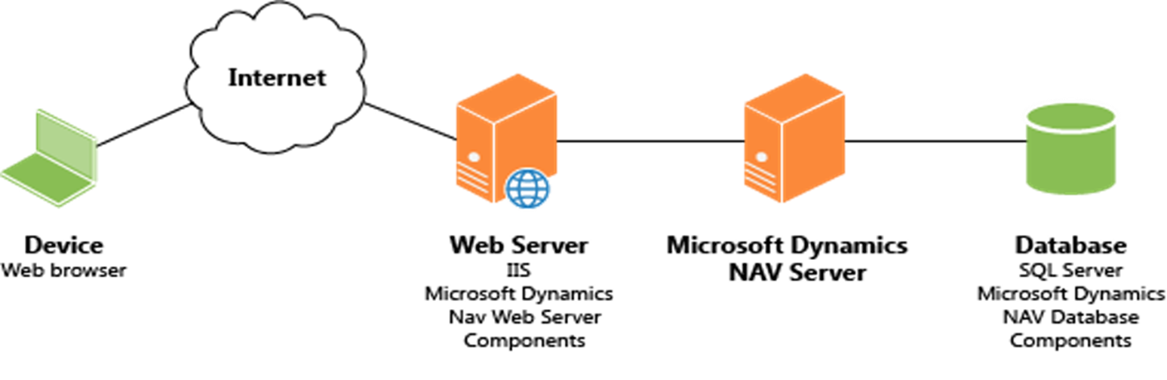

Slide 4
PURPOSE OF USING WEBCLIENT​ ​ 1 - Displays web pages received from the server​ 2 - Collects processed data from the web server​ 3 - Allows users to interact with the web server

Slide 5
Features and functionalities of a `WebClient` :​
​
1. HTTP Methods: `WebClient` supports common HTTP methods like GET, POST, PUT, DELETE, and more, allowing you to perform various types of requests.​
​
2. URL Handling: It can handle URL construction and parsing, making it easy to specify the target endpoint for your HTTP requests.​
​
3. Request Configuration: You can set request headers, query parameters, and request bodies as needed to customize the HTTP request.​
​
4. Asynchronous Operations: Many `WebClient` implementations support asynchronous operations, which can improve the responsiveness of your application by not blocking the main thread during network requests.​
​
5. Response Handling: It can handle HTTP responses, including status codes, headers, and response bodies. You can extract and process data from the response.

Slide 6

6. Error Handling: `WebClient` often includes mechanisms for handling errors, such as connection issues or server errors.​
7. Proxy Support: Some `WebClient` libraries allow you to configure and use proxy servers if needed.​
8. Cookie Management: It can manage cookies, enabling the handling of stateful web interactions.​
9. SSL/TLS Support: `WebClient` can usually handle secure HTTPS connections and certificate validation.​
10. File Upload and Download: It can be used to upload files to a server or download files from it.

Slide 7


HOW WEBCLIENT USED IN EXPRESS.JS​
we make HTTP requests and handle them using middleware and libraries available in the Node.js ecosystem. We can use the popular axios library for making HTTP requests in an Express.js application. Here's how We can use it:​
Install Axios:​
First, make sure we have Axios installed in our Express.js project. we can install it using npm or yarn:​
npm install axios​
Require Axios:​
In Express.js application, require the Axios library at the top of our JavaScript file:​
const axios = require('axios');​
Making an HTTP GET Request:​
To make an HTTP GET request to an external API or resource, we can use Axios like following

Slide 8
app.get('/api/data', (req, res) => {​
const url = 'https://example.com/api/data';​
​
axios​
.get(url)​
.then(response => {​
res.json(response.data); // Send the response from the external API to the client​
})​
.catch(error => {​
console.error(error);​
res.status(500).json({ error: 'An error occurred' });​
});​
});

Slide 9
In this example, we define a route that makes a GET request to https://example.com/api/data. When the request is successful, we send the data to the client. If an error occurs, we send an error response with a 500 status code.​
​
Making Other Types of Requests:​
To make other types of requests (e.g., POST, PUT, DELETE), you can use the corresponding Axios methods like axios.post(), axios.put(), and axios.delete().

